Slide 1
Construction Career Pathways
Career Exploration Toolkit

Slide 2

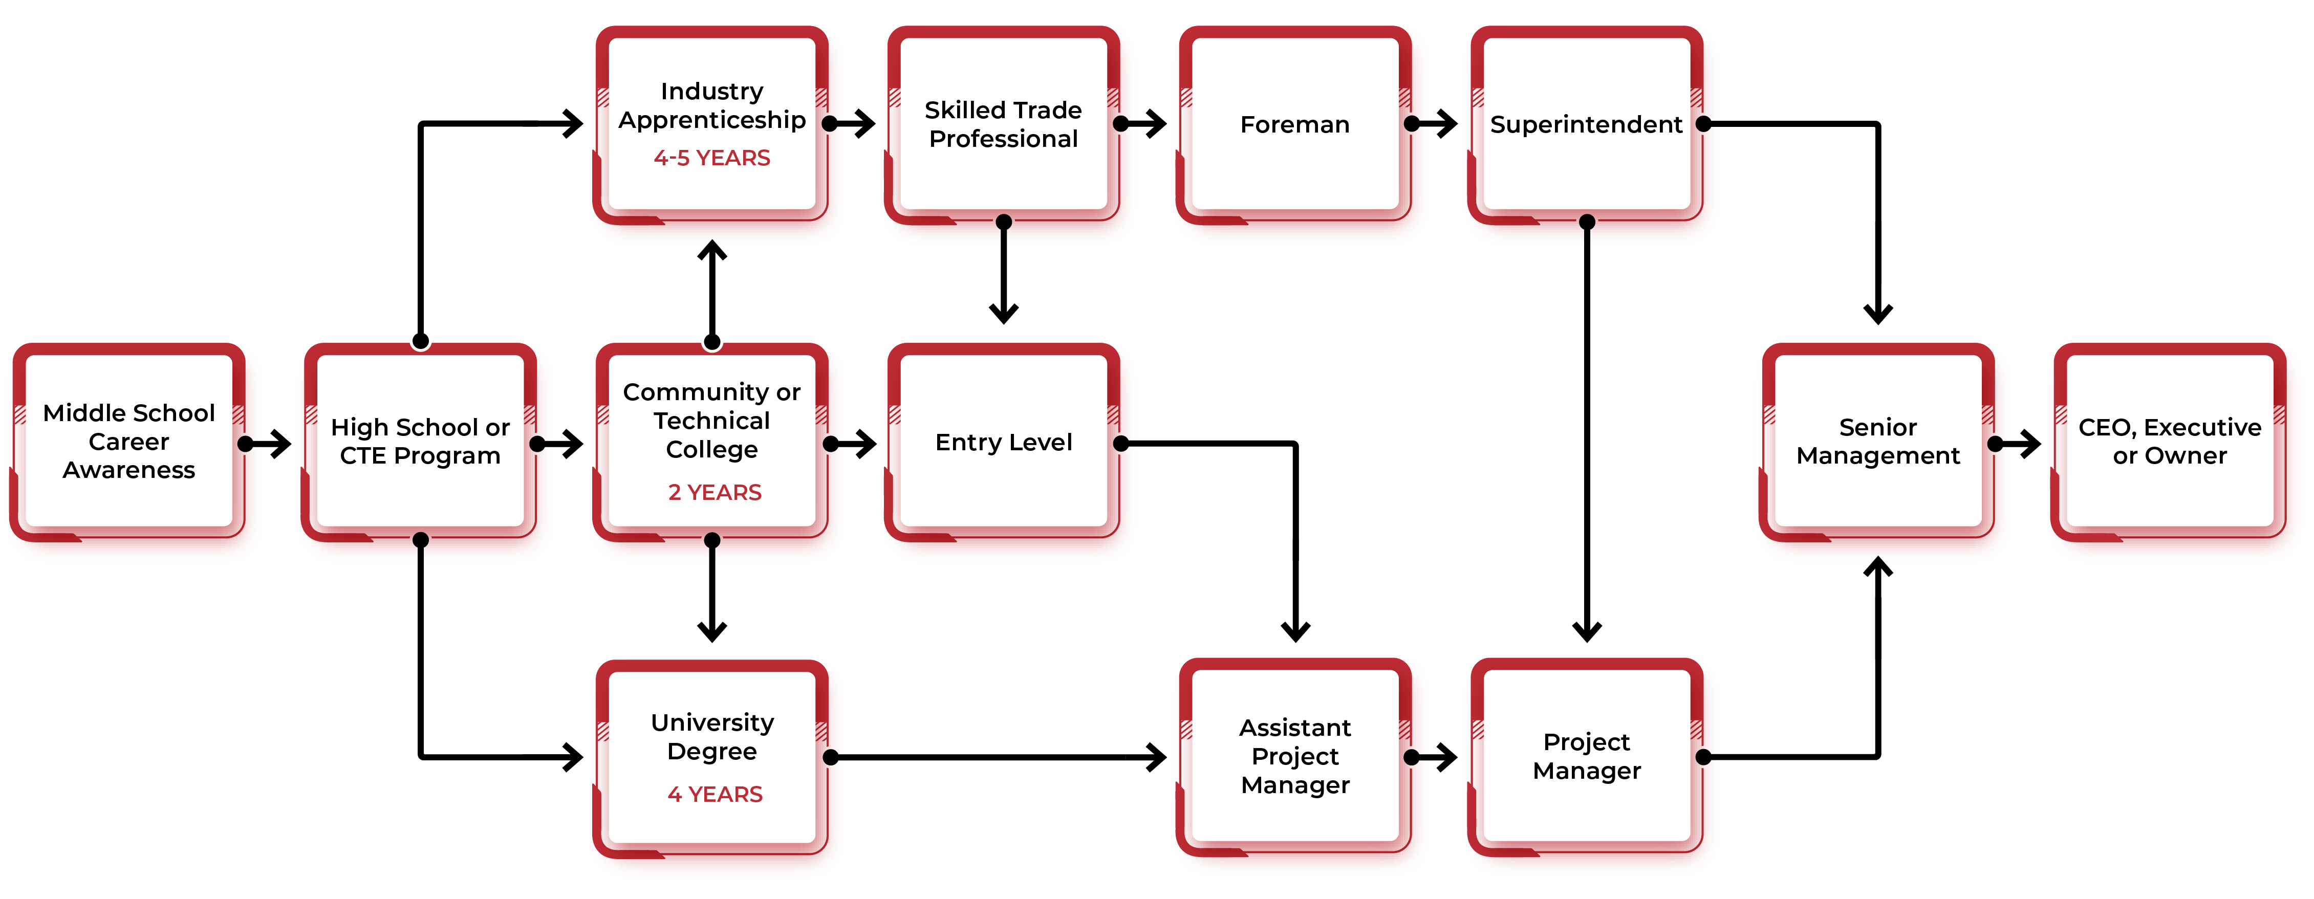
Pathways to Careers in Construction

Slide 3
Hands-On Builders

Slide 4
CARPENTERS
Carpenters cut, shape and install building materials in the construction of many kinds of projects. They are essential to the infrastructure you depend on daily like highways, bridges and more.
EDUCATION:
Three to four years of classroom and on-the-job training
SALARY:
$109,490* + Benefits Package
* Wages are based on a 40-hour work week at 50 weeks per year at the Philadelphia rate.
Insert photo from the workforce development card

Slide 5
CEMENT MASONS
Cement masons are in charge of the finishing and treatment of concrete structures. With precision, they make sure their projects meet architectural plans for sidewalks, roads and more.
EDUCATION:
Three-year apprenticeship and work in the field
SALARY:
$88,400* + Benefits Package
* Wages are based on a 40-hour work week at 50 weeks per year at the Philadelphia rate.
Insert photo from the workforce development card

Slide 6
IRON WORKERS
Ironworkers erect and install structural and reinforcing steel to build metal structures like bridges, stadiums and more in today’s construction world. Their work ensures the structural safety of single and multi-story buildings.
EDUCATION:
Three to four years of related technical training in classroom and shop, and on-the-job training
SALARY:
$96,400* + Benefits Package
* Wages are based on a 40-hour work week at 50 weeks per year at the Philadelphia rate.
Insert photo from the workforce development card

Slide 7
LABORERS
Construction laborers are tasked with a wide range of physical jobs on building sites. Depending on the job site, a laborer’s daily tasks may vary but are important to creating structurally safe buildings, roads and other infrastructure.
EDUCATION:
Two to four years of technical instruction and on-the-job training
SALARY:
$75,400* + Benefits Package
* Wages are based on a 40-hour work week at 50 weeks per year at the Philadelphia rate.
Insert photo from the workforce development card

Slide 8
Systems Specialists

Slide 9
ELECTRICIANS
Electricians install, maintain, and repair electrical systems in homes, businesses, and construction sites. They work with power, lighting, and control systems to keep buildings running safely and efficiently.
EDUCATION:
Five-year apprenticeship and work in the field
SALARY:
$141,940* + Benefits Package
* Wages are based on a 40-hour work week at 50 weeks per year at the Philadelphia rate.
Insert photo from the workforce development card

Slide 10
OPERATING ENGINEERS
Operating engineers often work with heavy equipment, a blanket term for many types of machines like cranes, bulldozers and more. Because operating engineers work with many different machineries, their skills are needed on a wide variety of job sites in industries such as highway and building construction.
EDUCATION:
Three to four years of classroom and on-the-job training
SALARY:
$94,000* + Benefits Package
* Wages are based on a 40-hour work week at 50 weeks per year at the Philadelphia rate.
Insert photo from the workforce development card

Slide 11
PIPEFITTERS
Pipefitters are in charge of assembling and installing piping systems for heating, cooling, and industrial use. They work to ensure their systems meet project specifications for buildings, plants and other complex structures.
EDUCATION:
Five-year apprenticeship and on-the-job training
SALARY:
$145,000* + Benefits Package
* Wages are based on a 40-hour work week at 50 weeks per year at the Philadelphia rate.
Insert photo from the workforce development card

Slide 12
PLUMBERS
Plumbers are responsible for installing and maintaining piping systems. They make sure water, gas, and drainage systems work safely in homes, buildings and job sites.
EDUCATION:
Five-year apprenticeship, on-the-job training, and work in the field
SALARY:
$135,000* + Benefits Package
* Wages are based on a 40-hour work week at 50 weeks per year at the Philadelphia rate.
Insert photo from the workforce development card

Slide 13
SHEET METAL WORKERS
Sheet metal workers fabricate and install metal for buildings and systems. They shape and fit materials for ductwork, roofing, siding, and kitchen equipment. Training includes HVAC, sheet metal fabrication and metal installation.
EDUCATION:
Four-to-five-year apprenticeship, on-the-job training, and classroom instruction
SALARY:
$118,440* + Benefits Package
* Wages are based on a 40-hour work week at 50 weeks per year at the Philadelphia rate.
Insert photo from the workforce development card

Slide 14
Planners & Leaders

Slide 15
ESTIMATORS
A construction estimator determines estimates for many construction projects by reviewing the plans, visiting the construction site and estimating how much money the project will cost to build.
EDUCATION:
Four-year bachelor’s degree
SALARY:
$63,000–$95,000*
* National average as reported by Glassdoor.
Insert photo from the workforce development card

Slide 16
PROJECT ENGINEERS
Project engineers manage the technical aspects of the job, translating the blueprints and making sure the project has the right materials, equipment and workers to execute the construction work.
EDUCATION:
Four-year bachelor’s degree
SALARY:
$79,000–$118,000*
* National average as reported by Glassdoor.
Insert photo from the workforce development card

Slide 17
PROJECT MANAGERS
A construction project manager oversees building projects from start to finish, leading the team to make sure the project stays within the budget and finishes on time.
EDUCATION:
Four-year bachelor’s degree
SALARY:
$85,000–$138,000*
* National average as reported by Glassdoor.
Insert photo from the workforce development card

Slide 18
PROJECT SUPERVISORS
Construction project supervisors are responsible for managing a project’s plan. They act as a middleman between other supervisors and management to make sure projects are completed in time.
EDUCATION:
Four-year bachelor’s degree
SALARY:
$63,000–$97,000*
* National average as reported by Glassdoor.
Insert photo from the workforce development card

Slide 19
SUPERINTENDENTS
The construction superintendent supervises the project from start to finish. Depending on the size of the project, their role may vary, but they make sure the project stays within the budget and complies to regulation requirements.
EDUCATION:
Four-year bachelor’s degree
SALARY:
$84,000–$129,000*
* National average as reported by Glassdoor.
Insert photo from the workforce development card

Slide 20
Detail Finishers

Slide 21
DRYWALL FINISHERS
A drywall finisher meticulously completes the finishing touches on drywall panels secured to either wooden or metal frames, ensuring all surfaces are smoothed out and establishing a sturdy foundation for any structure.
EDUCATION:
Three to four years of classroom and on-the-job training
SALARY:
$84,420* + Benefits Package
* Wages are based on a 40-hour work week at 50 weeks per year at the Philadelphia rate.
Insert photo from the workforce development card

Slide 22
GLAZIERS
Glaziers and glassworkers install, cut, and fit glass for windows, doors, curtain walls, and facades in commercial and residential buildings.
EDUCATION:
Three-to-four-year apprenticeship, on-the-job training, and classroom instruction
SALARY:
$99,920* + Benefits Package
*Wages are based on a 40-hour work week at 50 weeks per year at the Philadelphia rate.
Insert photo from the workforce development card

Slide 23
INSULATORS
Insulators oversee installing and applying materials that control temperature and sound. They make sure buildings and systems are energy efficient and meet safety standards in all types of environments.
EDUCATION:
Five-year apprenticeship and on-the-job training
SALARY:
$121,680* + Benefits Package
* Wages are based on a 40-hour work week at 50 weeks per year at the Philadelphia rate.
Insert photo from the workforce development card

Slide 24
Learn more about careers in construction by visiting GBCA.com

