Slide 1
June 2026
US Construction Outlook:
What’s in the Mix for the Rest of ’26 (and Beyond)?
Ken Simonson
Chief Economist, AGC of America
ken.simonson@agc.org
©2026 The Associated General Contractors of America, Inc.

Slide 2
Nonresidential jobs are increasing; residential employment is falling
Year-over-year % change in employment, Jan. 2023-Apr. 2026, seasonally adjusted
% change since:
Mar. 2026
Apr. 2025
Nonresidential Construction
0.4%
2.0%
Total Construction
0.1%
0.6%
Total Nonfarm
0.1%
0.2%
Residential Construction
-0.3%
-1.5%
Source: BLS current employment statistics, https://www.bls.gov/ces/
©2026 The Associated General Contractors of America, Inc.

Slide 3
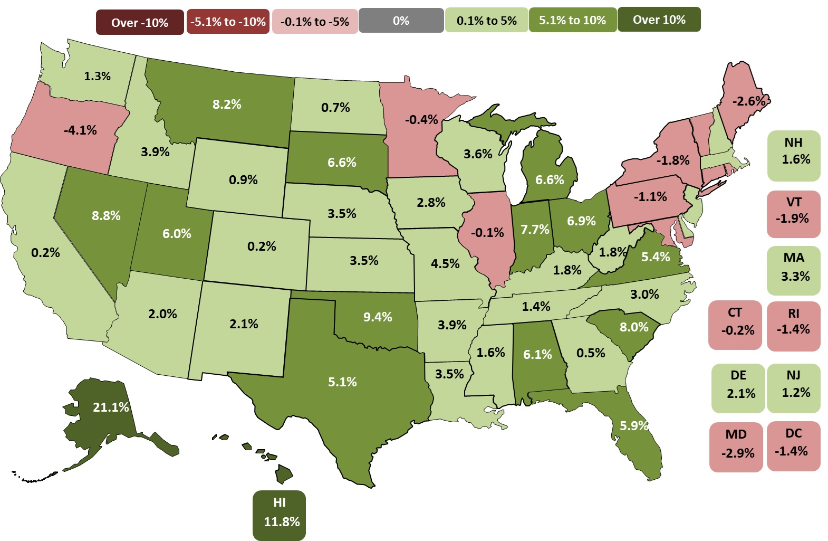
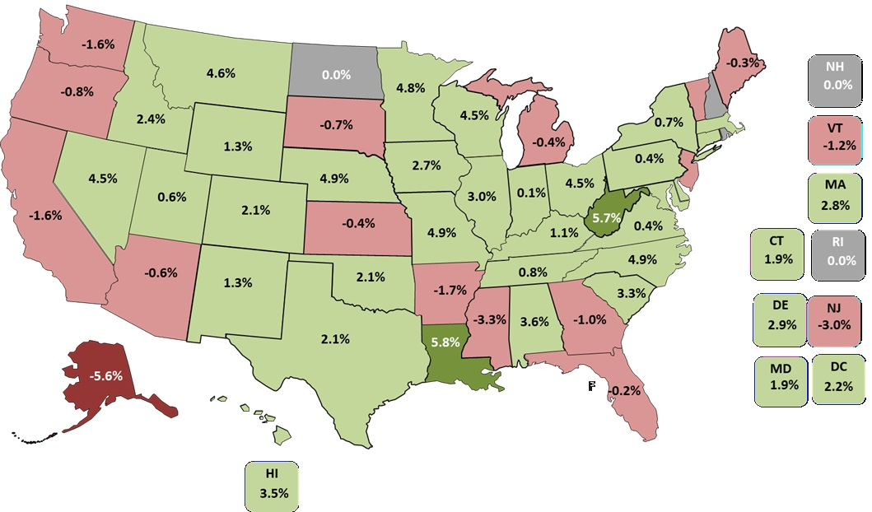
Construction job growth is uneven across states
32 states & DC up & 15 states down & 3 state unchanged Apr. 2025-Apr. 2026 (U.S.: up 0.6%)
172 metros (48%) up, 149 (41%) down, 39 unchanged
Top 5
LA | 5.8%
WV | 5.7%
NC | 4.9%
NE | 4.9%
MO | 4.9%
Bottom 6
AK | -5.6%
MS | -3.3%
NJ | -3.0%
AR | -1.7%
CA, WA | -1.6%
Source: Bureau of Labor Statistics, state and area employment, www.bls.gov/sae
©2026 The Associated General Contractors of America, Inc.

Slide 4
Low rates for hires and job openings but also layoffs (“low hire, low fire”)
Construction hires, job openings, and layoffs as % of Mar. employment, 2001-26
Mar. 2026
Mar.
2025
Hires
3.7%
3.6%
Job openings
2.6%
3.3%
Layoffs
1.7%
2.0%
Source: Bureau of Labor Statistics, www.bls.gov/jlt, Job Openings & Labor Turnover Survey (JOLTS)
©2026 The Associated General Contractors of America, Inc.

Slide 5
Spending trends: mix of increases and decreases
Billions of dollars, seasonally adjusted annual rate, Apr. 2025-Apr. 2026
$2,172B Total 0.9%: $922B Residential 2% (Private single-family -3%; multi 1%; improvements 8%); public 4%
$1,250B Nonresidential 0.3% (private -2%, public 4%)
Nonresidential segments (in descending order of April 2026 spending; combined new & renovation spending)
$186B Mfg. -18% (computer/electronic -44%; chemical 11%; food/beverage/tobacco 12%; transportation equipment -8%)
$168B Power 7% (electric 8%; oil/gas fields & pipelines -1%)
$151B Highway and street 4% (pavement 3%; bridge 8%)
$140B Educational 2% (primary/secondary 2%; higher ed -1%; pre-primary, libraries, museums, misc. 8%)
$122B Commercial 0.8% (warehouse -2%; retail 6%; farm -1%)
$114B Office including data centers 7% (data centers 28%; other private office -5%; public office -3%)
$ 71B Health care 3% (hospital 4%; medical building 0.8%; special care 3%)
$ 70B Transportation 3% (air 7%; private rail/truck 4%; transit -13%)
$229B Other 6%:
Sewage/waste 5%; Amuse/recreation 8%; Water supply 5%; Communication 3%; Lodging 6%; Public safety 2%; Conserv/dev 18%; Relig 20%
Source: Author, from U.S. Census Bureau, www.census.gov/constructionspending
©2026 The Associated General Contractors of America, Inc.

Slide 6
Tariffs are pushing up costs of construction materials, equipment
producer price indexes (PPIs), changes through Apr. 2026 (not seasonally adjusted)
April 2026 change from:
Mar. 2026 Apr. 2025 Feb. 2020
(1 month) (12 months) (74 months)
Overall input costs are rising again and have outpaced the CPI since 2020
PPI for inputs to new nonresidential construction |  | 1.7% | 6.6% | 49%
Consumer price index (CPI) |  | 0.9% | 3.8% | 29%
...and domestic input prices for items competing with tariff-burdened imports soared
Diesel fuel |  | 14% | 74% | 158%
Steel mill products |  | 3.8% | 13% | 84%
Aluminum mill shapes |  | 4.2% | 37% | 95%
​Copper and brass mill shapes |  | 0.9% | 21% | 104%
Construction machinery and equipment |  | 0.1% | 4.0% | 37%
Source: Bureau of Labor Statistics, www.bls.gov/ppi
©2026 The Associated General Contractors of America, Inc.

Slide 7
Tariff announcements & dates affecting construction (as of June 3)
(more at AGC Tariff Resource Center: www.agc.org/tariff-resources-contractors)
Supreme Court ruling invalidates many country-specific tariffs but not materials tariffs
Contractors can get refunds only if they are importers-of-record or tariffs are shown on invoice
President Trump imposed a new 10% tariff; blocked by court for now
Still in effect:
Steel & aluminum: 25% on March 12, 2025; 50% on June 4, 2025
Copper: 50% on Aug. 7 for copper products, not unprocessed copper
Lumber: 10% on Oct. 1; duties on Canadian lumber raised from 14.5% to 35% in early August
Cars & light trucks: 25%; medium and heavy trucks: 25% on Nov. 1; lower rate for parts, USMCA
Fee on Chinese ships calling on U.S. ports: began on Oct. 14; suspended as of Nov. 10
Source: White House and media reports
©2026 The Associated General Contractors of America, Inc.

Slide 8
Construction pay increases continue to outpace the private sector
BLS: Average hourly earnings for production and nonsupervisory employees (Apr. 2025-Apr. 2026):
Construction 4.8% Private sector 3.7%
CLRC: First-year settlements for construction union contracts: 4.7% (2025)
PAS: Construction firm executive increases: 4.5% in 2025; 4.-4.5% anticipated in 2026 (Mar. 2026)
Source: Author
©2026 The Associated General Contractors of America, Inc.

Slide 9
Foreign-born share of construction trade workers varies greatly by trade
Occupation | Foreign born | Occupation | Foreign born
Plasterers & Stucco Masons | 57% | Carpenters | 35%
Drywall Installers, Ceiling Tile Installers, & Tapers | 57% | Pipelayers | 28%
Roofers | 53% | Plumbers, Pipefitters, & Steamfitters | 18%
Painters & Paperhangers | 53% | Solar Photovoltaic Installers | 17%
Carpet, Floor, & Tile Installers and Finishers | 51% | Sheet Metal Workers | 17%
Construction Laborers | 44% | Structural Iron & Steel Workers | 16%
Brick, Block, & Stone Masons | 39% | Glaziers | 16%
Insulation Workers | 38% | Electricians | 16%
Cement Masons, Concrete Finishers, Terrazzo Workers | 36% | Construction Equipment Operators | 14%
Source: Harvard Joint Center for Housing Studies from Census Bureau, 2024 American Community Survey 1-Year Ests.
©2026 The Associated General Contractors of America, Inc.

Slide 10
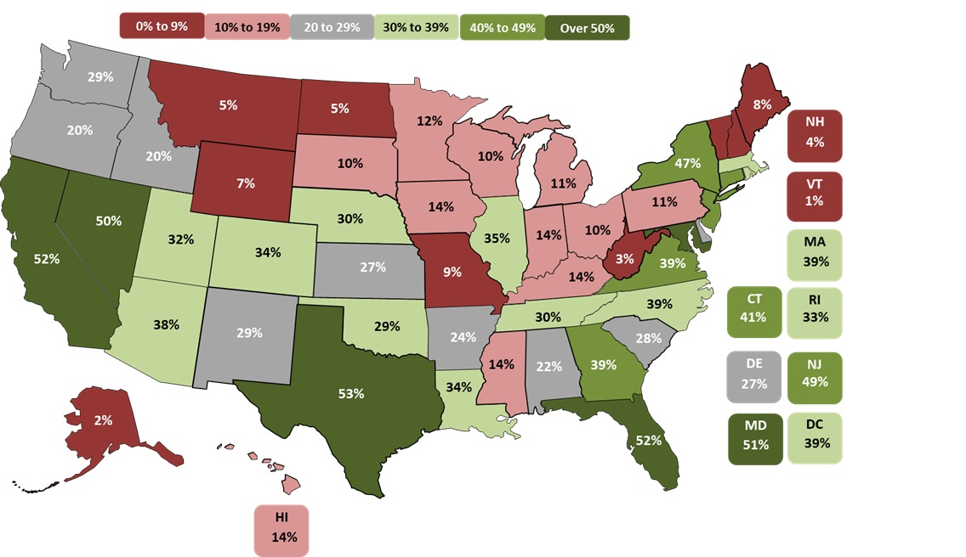
Construction trades rely heavily on immigrants (35% vs. 18% for all workers); impact varies greatly by state (1-53%); WA: 29%
Share of construction trade workers who are foreign born by state, 2024
Top 6
TX | 53%
CA, FL | 52%
MD | 51%
NV | 50%
NJ | 49%
Bottom 6
VT | 1%
AK | 2%
WV | 3%
NH | 4%
MT, ND | 5%
Source: Harvard Joint Center for Housing Studies from Census Bureau, 2024 American Community Survey 1-Year Ests.
©2026 The Associated General Contractors of America, Inc.

Slide 11
Middle East war adds to uncertainty
Fuel prices hit construction directly and via surcharges
Natural gas price affects cost of construction plastics
Energy cost affects cost of all materials & equipment
Alumina shutdown will drive aluminum prices, supply chain
Other imports may face longer delivery times, higher fuel costs
Owners may delay projects based on input costs, availability
Reduced travel, other spending may hit hotel, retail construction
Less investment by Middle East public and private investors

Slide 12
Likely policy impacts on construction
Higher tariffs will raise costs, invite retaliation, may disrupt supply chains
Harsh immigration/deportation actions will worsen construction labor shortages
Expectation of larger deficits pushed interest rates higher
However, lessened federal regulatory hurdles may help projects start sooner
OBBBA adds certainty about corporate taxes; may lead to speedup of some investments
Source: Author
©2026 The Associated General Contractors of America, Inc.

Slide 13
Medium-term outlook: slow growth, risk of stalling, higher prices
Economic growth is unbalanced and vulnerable to war shock; inflation risk is high, recession less so
Single-family: gradual pickup if mortgage rates don’t spike; multifamily close to bottoming out
Warehouse, office: declines likely throughout 2026 given high costs, weak demand
Best bets for growth: data centers, power, airports, specialty health care
Mfg. construction: canceled & deferred projects likely to outweigh new starts
Materials costs: up 3-5%, much more if Middle East war lasts
Supply chain: few problems so far except electrical gear; problems will grow if war continues
Labor costs: up 4-5%; ICE actions make availability a challenge
Source: Author
©2026 The Associated General Contractors of America, Inc.

Slide 14
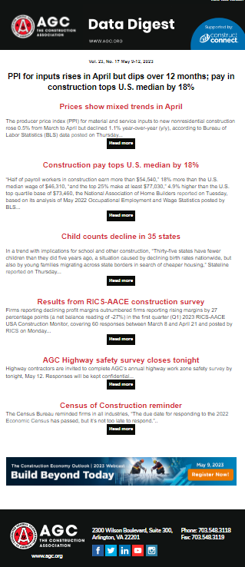
AGC economic resources
(email ken.simonson@agc.org)
Data DIGest: weekly email summary of construction economic news (subscribe)
AGC Tariff Resource Center
State and metro data, fact sheets
Monthly press releases: construction spending; producer price indexes; national, state, metro employment with rankings
Construction impact model: www.agc.org/agc-construction-impact-model
ConsensusDocs Price Escalation Resource Center
Source: Author
©2026 The Associated General Contractors of America, Inc.

